Slide 1


T1934
Binary trees, Tree traversals
A Quest Global Company
06/06/2025

Slide 2
Agenda
Topics Covered Today
Key Learnings / Concepts Understood:
Key Concepts with Definitions/ Code Snippet – Hands-on Practice
Challenges / Debugging Experience
Tasks/Assignments Completed
Additional Learning Resources / Notes
Q&A
Plan for Tomorrow

Slide 3
Topics Covered Today
Binary trees
Tree traversals

Slide 4
Key Learnings/Concepts Understood
A binary tree is a hierarchical structure where each node has up to two children (left and right).
Each node contains data and pointers to its left and right child nodes.
Types include full, perfect, complete, skewed, and balanced binary trees.
A Binary Search Tree (BST) maintains the property: left child < parent < right child.
Inorder traversal visits nodes in left-root-right order and gives sorted output in BST.
Preorder traversal visits nodes in root-left-right order, useful for copying trees.
Postorder traversal visits nodes in left-right-root order, used for deleting trees.
Level order traversal visits nodes level-by-level using a queue (BFS).

Slide 5
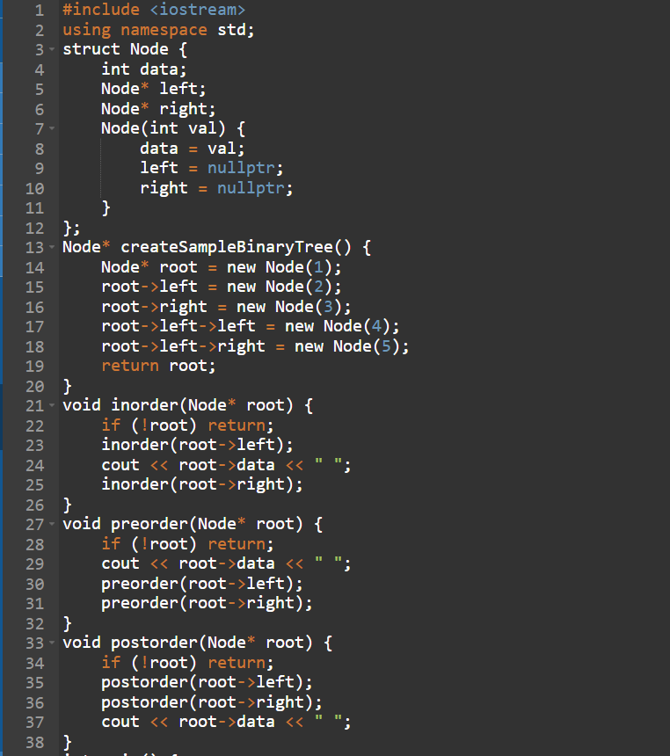
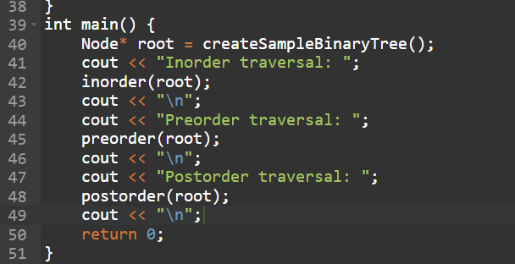


Key Concepts with Definitions/ Code Snippet – Hands –on Practice
1.Binary trees
Full Binary Tree
Definition:
A binary tree is a hierarchical structure where each node has up to two children (left and right).

Slide 6
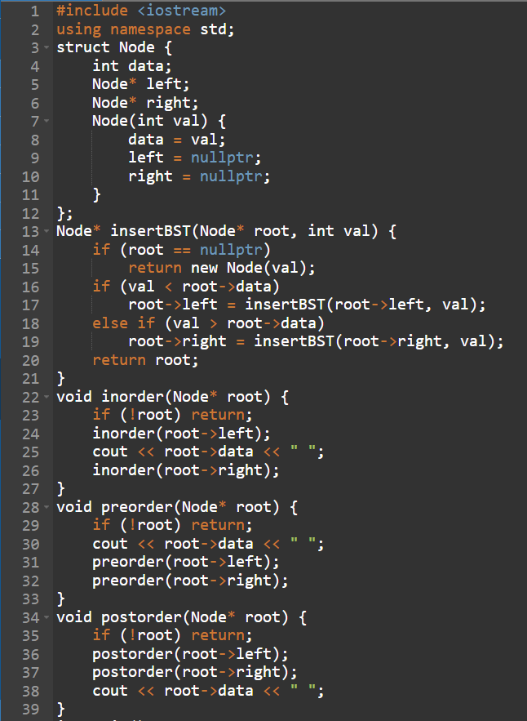
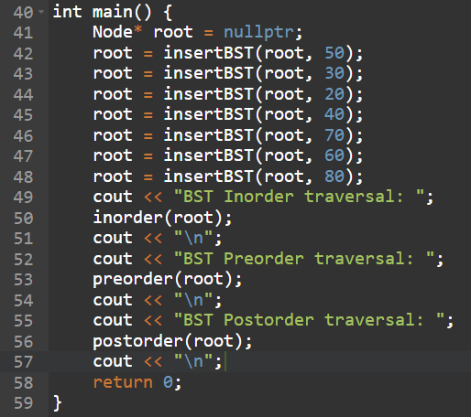

Binary Search Tree (BST)
Definition:
A BST is a binary tree where for every node:
Left subtree has nodes with values less than the node’s value.
Right subtree has nodes with values greater than the node’s value.

Slide 7
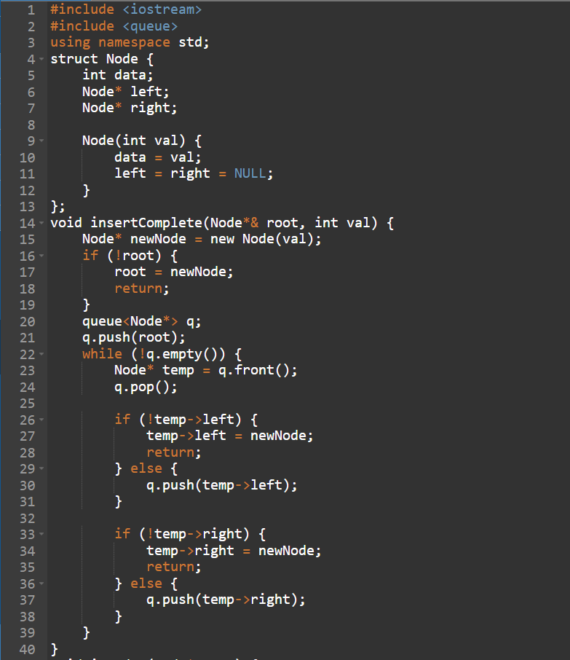
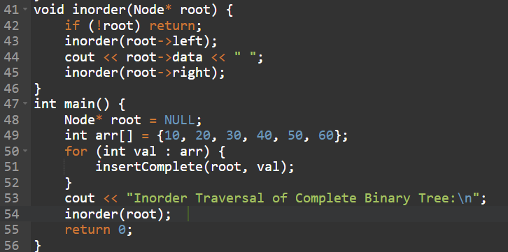

Complete Binary Tree
Definition:
All levels are full except possibly the last, and nodes are filled left to right.

Slide 8
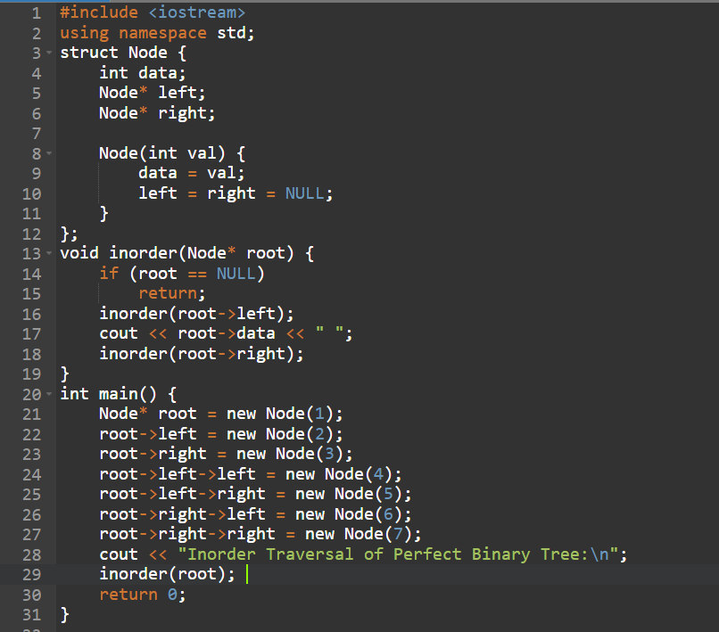

Perfect Binary Tree
Definition:
All internal nodes have two children and all leaves are at same level.

Slide 9
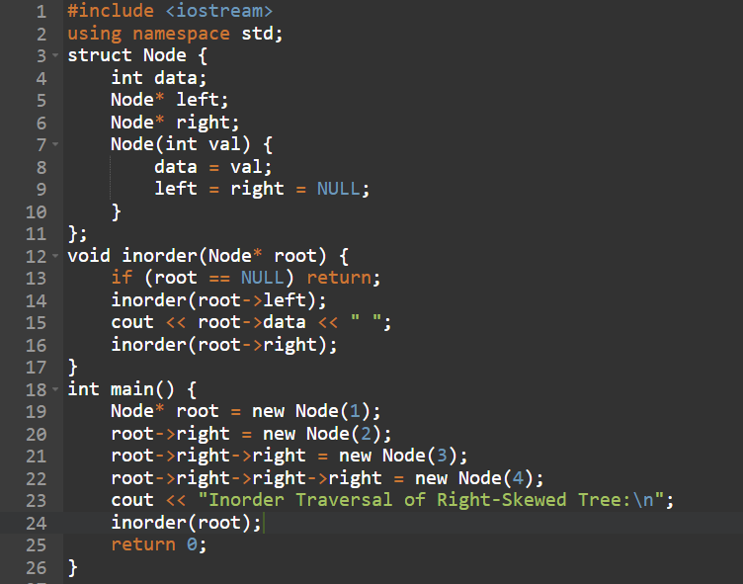

Degenerate (Skewed) Tree
Definition:
Each parent has only one child.

Slide 10
Type | Characteristics
Full Binary Tree | 0 or 2 children per node
Perfect Binary Tree | All internal nodes have 2 children & all leaves at same level
Complete Binary Tree | Last level left-filled
Balanced Binary Tree | Height difference ≤ 1
Degenerate Tree | Like a linked list (1 child per node)
Binary Search Tree | Left < root < Right
Threaded Binary Tree | NULL pointers replaced to speed up traversal
AVL / Red-Black Tree | Self-balancing BSTs

Slide 11
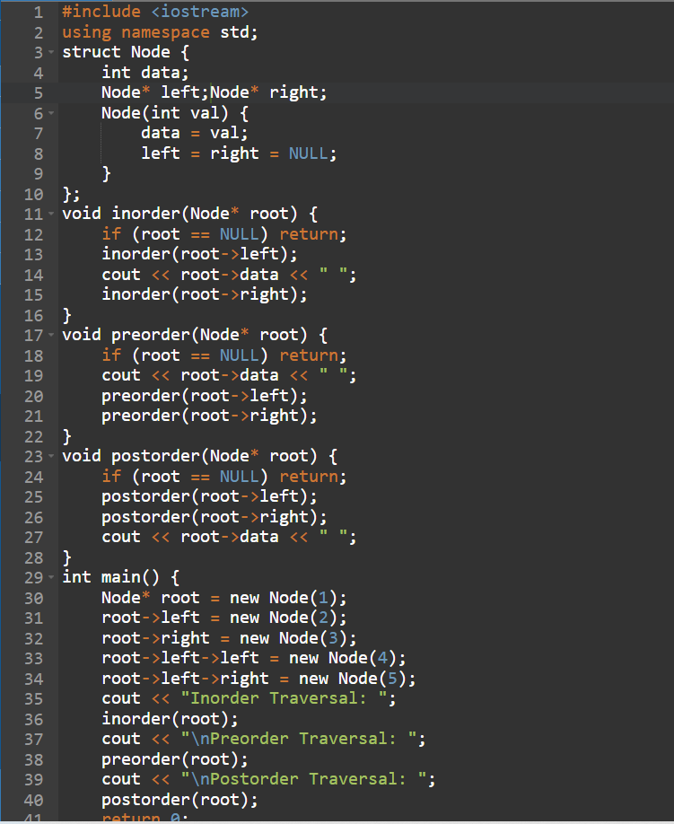

2.Tree traversals
Definition:
Tree traversal refers to the process of visiting all the nodes of a tree in a specific order. There are three main types for binary trees:
Inorder Traversal (Left → Root → Right)
Preorder Traversal (Root → Left → Right)
Postorder Traversal (Left → Right → Root)

Slide 12
Challenges / Debugging Experience
Null pointer errors when accessing child nodes that don’t exist.
Infinite recursion caused by missing base cases in traversal or insertion functions.
Incorrect traversal order due to wrong recursive call sequence.
Memory leaks when dynamically allocating nodes but not freeing them properly.
Wrong insertion logic breaking the BST property.
Stack overflow for very deep or skewed trees due to deep recursion.
Confusion between preorder, inorder, and postorder traversals during implementation.
Off-by-one errors or incorrect loop bounds when performing iterative traversals.

Slide 13
Additional Learning Resources / Notes
Data Structures and Algorithms in C++” by Goodrich, Tamassia, and Mount (book).
“Introduction to Algorithms” (CLRS) by Cormen, Leiserson, Rivest, and Stein (book).
GeeksforGeeks website for articles and practice problems.
TutorialsPoint for clear explanations and examples.
MIT OpenCourseWare and Abdul Bari’s YouTube playlists for video lectures.
Practice problems on LeetCode, HackerRank, and Codeforces.
Visualgo.net for interactive tree visualizations.

Slide 14
Q&A
Q1: What is a binary tree? A: A tree data structure where each node has at most two children (left and right).
Q2: What is a Binary Search Tree (BST)? A: A binary tree where left child nodes have smaller values and right child nodes have larger values than the parent.
Q3: Name the types of tree traversals. A: Inorder, Preorder, Postorder, and Level order.
Q4: Which traversal gives nodes in sorted order for BST? A: Inorder traversal.
Q5: What traversal is used to copy or serialize a tree? A: Preorder traversal.
Q6: Which traversal helps in deleting a tree? A: Postorder traversal.

Slide 15
Plan for Tomorrow
Basics of Graphs
Graph Traversal
Shortest Path
Minimum Spanning Tree
Cycle Detection in Graphs

Slide 16
Overall Overview
Binary trees are hierarchical data structures where each node has up to two children (left and right).
They are fundamental for representing hierarchical data and are the basis for advanced structures like Binary Search Trees (BST).
BSTs maintain an order where left child < parent < right child, enabling efficient search, insertion, and deletion.
Tree traversals are methods to visit all nodes systematically:
Inorder (Left, Root, Right) — yields sorted order in BSTs.
Preorder (Root, Left, Right) — useful for copying or saving tree structure.
Postorder (Left, Right, Root) — useful for deleting trees.
Level order — visits nodes by depth level, using a queue.
Understanding and implementing tree traversals is crucial for solving many algorithmic problems.
Common challenges include managing recursion carefully and handling null pointers.
Mastery of binary trees provides a strong foundation for learning more complex data structures and algorithms.

Slide 17


Thank You

